Slide 1
Torry Harris Business Solutions.
Bootcamp Batch-94,Group-5.
E-Commerce Project on “Green Dreams”
Presented by-
1.Subramanya Pujari
2.Bhanudas Kulkarni
3.Brundha Gowda
4.Geethanjali Puttal
5.Desh Deepak Chaudhary

Slide 2
Introduction
An E-Commerce Project on “Green Dreams". A Green Dreams is a Platform to buy or sell the Plants Online.
By this Website you can buy or sale as many plants as you need with both indoor and outdoor plants.

Slide 3
System Requirements
Hardware requirements
Storage: 250 GB
Ram: 8 GB
Processor: i3 or higher
Software requirements:
Programming Language: Java 8.
Front End-Thymeleaf
BackEnd-Java,SpringBoot.
IDE: Spring Tool Suite.

Slide 4
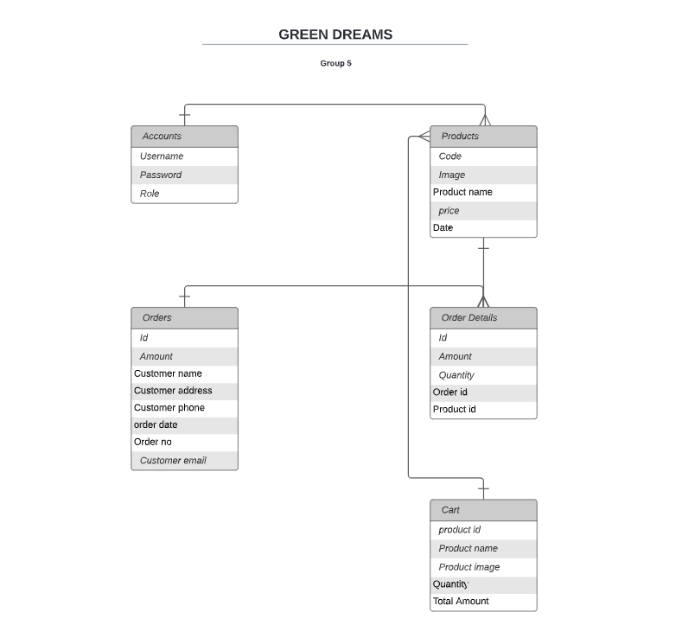
ER-Diagram

Slide 5
Objectives
To make one stop shop for all the Garden needs.
To Provide wide range of plants
To make gardening easier for the urban population

Slide 6
Conclusion
Learnt how a team works.
Built a fully functional E-Commerce application.
A friendly website to purchase or sell plants.

Slide 7
Screenshots of Projects.

Slide 8
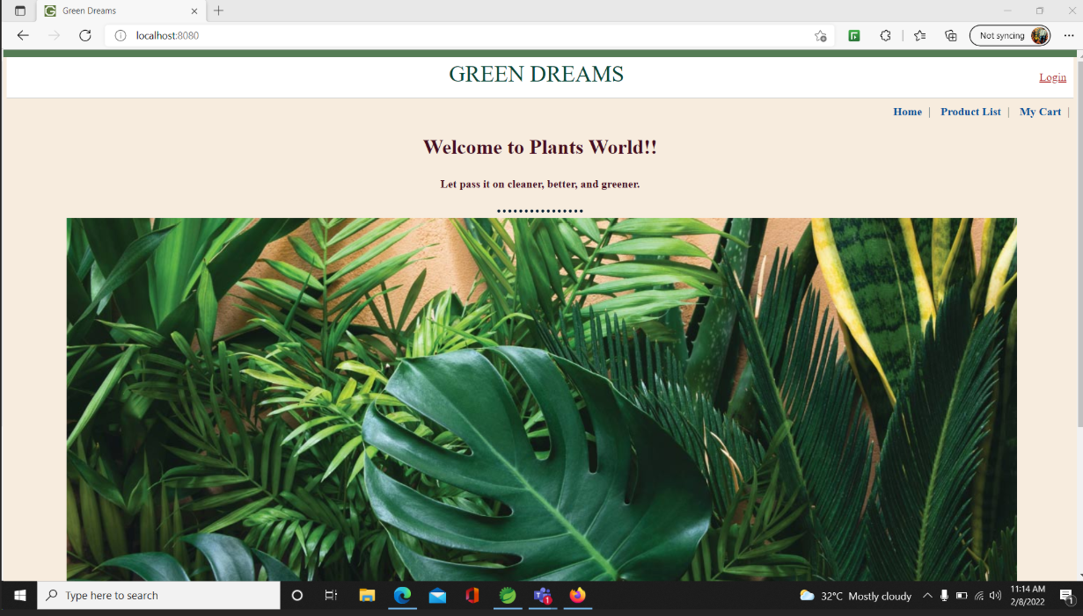
Home page

Slide 9
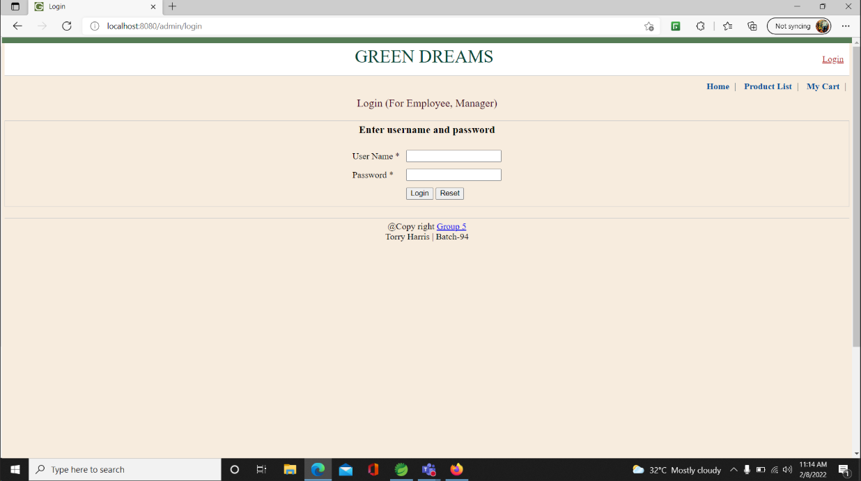
Login Page

Slide 10
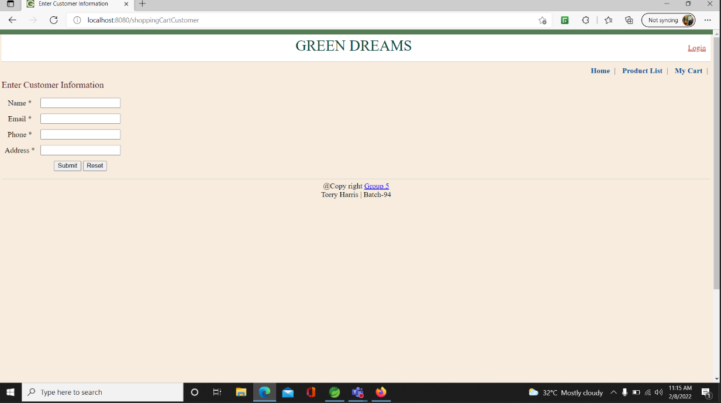
Customer information

Slide 11
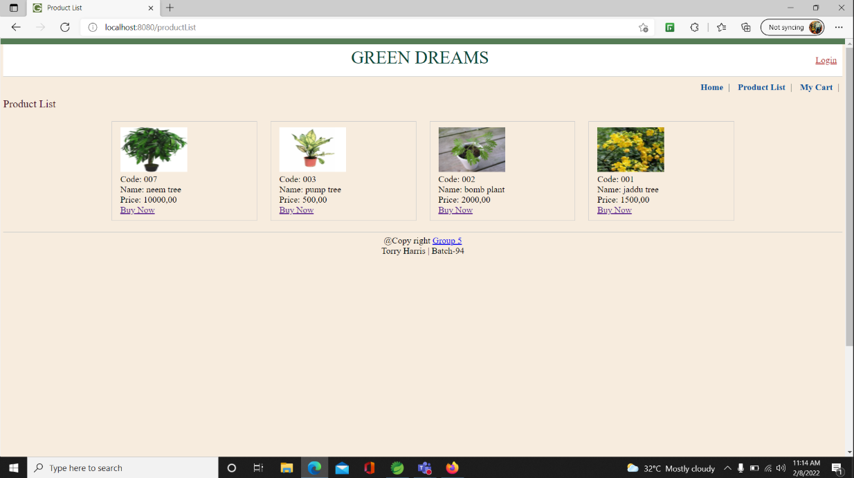
Product List

Slide 12
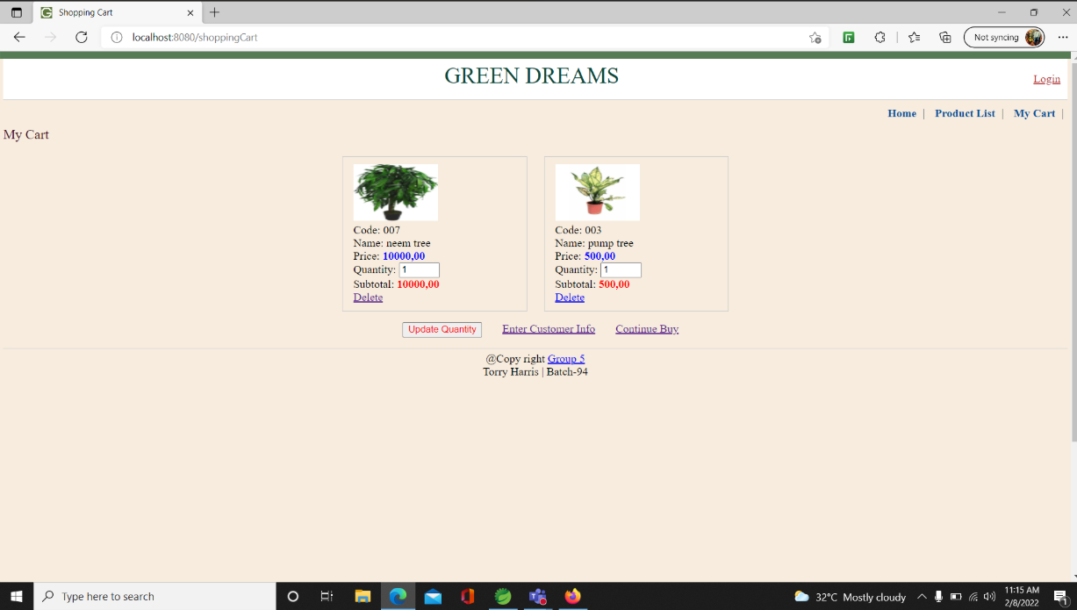
My Cart

Slide 13
Thank You.

